Slide 1
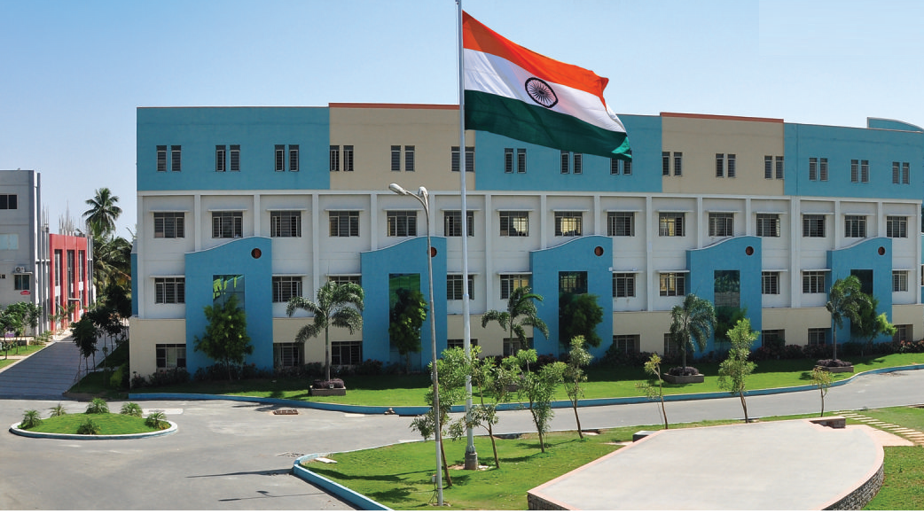
SRI ESHWAR COLLEGE OF ENGINEERING academic year: 2016-17 department: section:
FINAL YEAR PROJECT REVIEW – 1
Date of review:

Slide 2
Title of the project
Batch Members
1. Tamil Selvan D
2. Raghu Ram M
3. Vignesh T
4. Vasister A
Guide Name
Dr.C.Venkatesh
Asso.Prof/ECE Dept.

Slide 3
Presentation Outline
Name and Address of Company and External Guide details (If Applicable)
Abstract
Literature Survey
Objective
Expected Outcome
Execution Plan

Slide 4
Abstract of the project
These days we have an increased number of heart diseases including increased risk of heart attacks. Our proposed system users sensors that allow to detect heart rate of a person using heartbeat sensing even if the person is at home. The sensor is then interfaced to a microcontroller that allows checking heart rate readings and transmitting them over internet. The user may set the high as well as low levels of heart beat limit. After setting these limits, the system starts monitoring and as soon as patient heart beat goes above a certain limit, the system sends an alert to the controller which then transmits this over the internet and alerts the doctors as well as concerned users. Also the system alerts for lower heartbeats. Whenever the user logs on for monitoring, the system also displays the live heart rate of the patient. Thus concerned ones may monitor heart rate as well get an alert of heart attack to the patient immediately from anywhere and the person can be saved on time.

Slide 5
Literature Survey
Aibek Ryskaliyev,Sanzhar Askaruly,Alex Pappachen James 2016 , Speech signal analysis for the estimation of heart rates under different emotional states ,International Conference on Advances in Computing, Communications and Informatics (ICACCI).
Jatin Arora, Gagandeep, Amandeep Singh 2014, Heartbeat rate monitoring system by pulse technique using HB sensor,International Conference on Information Communication and Embedded Systems (ICICES2014).

Slide 6
Literature Survey (Cont’d..)
Chenggao Han, Hashimoto, T & Suehiro, N (2010), “Constellation-rotated vector OFDM and its performance analysis over rayleigh fading channels”, IEEE Trans. Commun., vol.58, pp. 828-838. (paper title format)
(Minimum three lines about above mentioned paper)
Per slide 2 papers- Maximum of 2 slides

Slide 7
Objectives

Slide 8
Introduction

Slide 9
Introduction (Cont’d..)

Slide 10
Key Skills

Slide 11
Block Diagram (or) Circuit Diagram

Slide 12
Explanation

Slide 13
Feasibility Analysis

Slide 14
Expected Outcome (or) Results and Discussion

Slide 15
Competitions Targeted
(Example)
Mitsubishi
NI
TI
ICTACT
Project Competitions from other Colleges

Slide 16
How this project will be converted into commercial product?

Slide 17
Journal Publications related to the Project

Slide 18
Work Schedule

Slide 19
References
Minimum 5 Recent journal paper references

Slide 20
Queries?

